Slide 1
Spend Forecasting and Drift Monitoring
Francesca Felizardo
IOD Capstone Project
August 20, 2025

Slide 2
Agenda
01 | Project Background (Voice of Customer)
02 | Overall Business Objective and Data Solution
03 | Dataset Overview
04 | Time Series Spend Forecasting
05 | Drift Monitoring
06 | Deployment
07 | Conclusion and Future Work

Slide 3
Voice of Customer
I feel that my spend is understated and/or overstated. I don’t have accurate spend guidance
I cannot plan for my category and do proper category management because I don’t have the right spend information
Which supplier/s do I spend the most and least for my category, is this changing over time? I need this to manage relationships
Are there changes to how each category is behaving through time?
We are at the heart of the renewable energy transition and being able to understand and ultimately plan ahead on expenditure is key to our success

Slide 4
Enable and drive faster, more agile and informed decisions through smarter spend and supplier insights.

Slide 5
Overall Data Science Objective and Solution
Intelligent Invoice Categorisation and Spend Forecasting with Drift Monitoring
Find a solution to correctly classify invoices, illustrate and predict spend and category trends through time and deploy for business consumption
Stage 1
Invoice Spend Classification
Stage 2
Time Series Spend Forecasting
Stage 3
Drift Monitoring
Stage 4
Deployment
Arima
Exponential Smoothing
Random Forest
Error Based based Drift Detection
Spend Based Drift Detection
Results in CSV format to be used as input to Power BI
Mini Project 3
Complete
Capstone Project Scope

Slide 6
Datasets Overview
Spend Data
Total Spend through Time
Spend by L1 Category
Approximately five years (2021 – 2025) of real Invoice spend data from a Utility Company
Spend Category Labelled
Supplier Information
Invoice Amount
Spend by Supplier

Slide 7



Time Series Forecasting Methodologies
ARIMA
Exponential Smoothing
Random Forest
Good for linearity and short-term dependencies
Statistical: Uses past values (AR) and past errors (MA) after differencing (I)
Simple, interpretable, handles trend & seasonality well
Statistical: Weighted average of past observations
Captures nonlinear relationships and complex interactions
Machine Learning: Treats forecasting as regression using lagged features and aggregates multiple decision trees

Slide 8



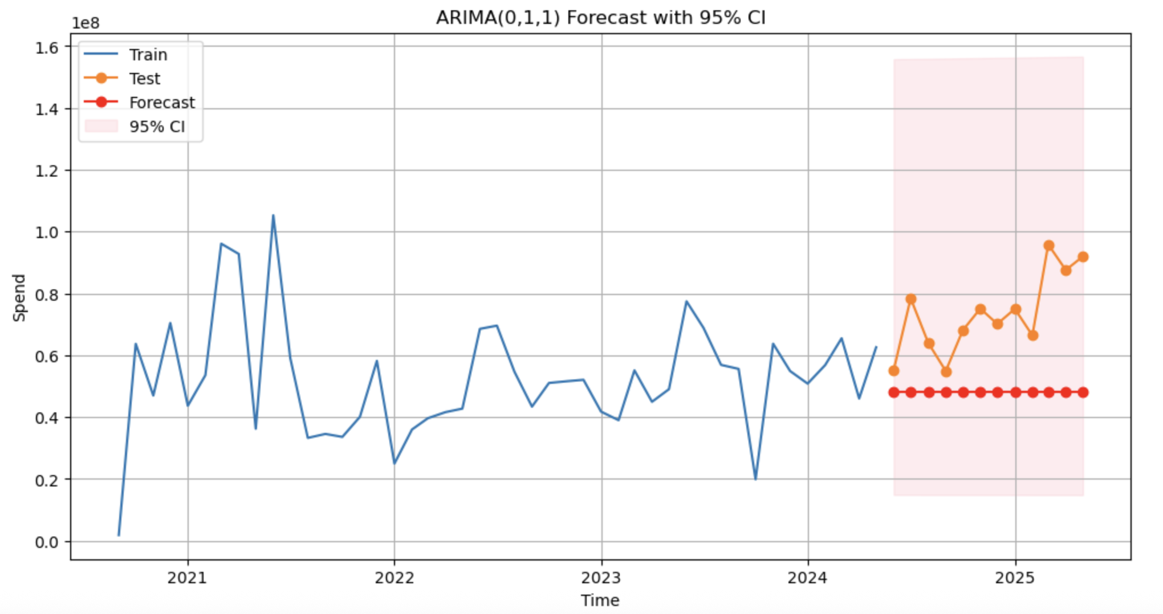
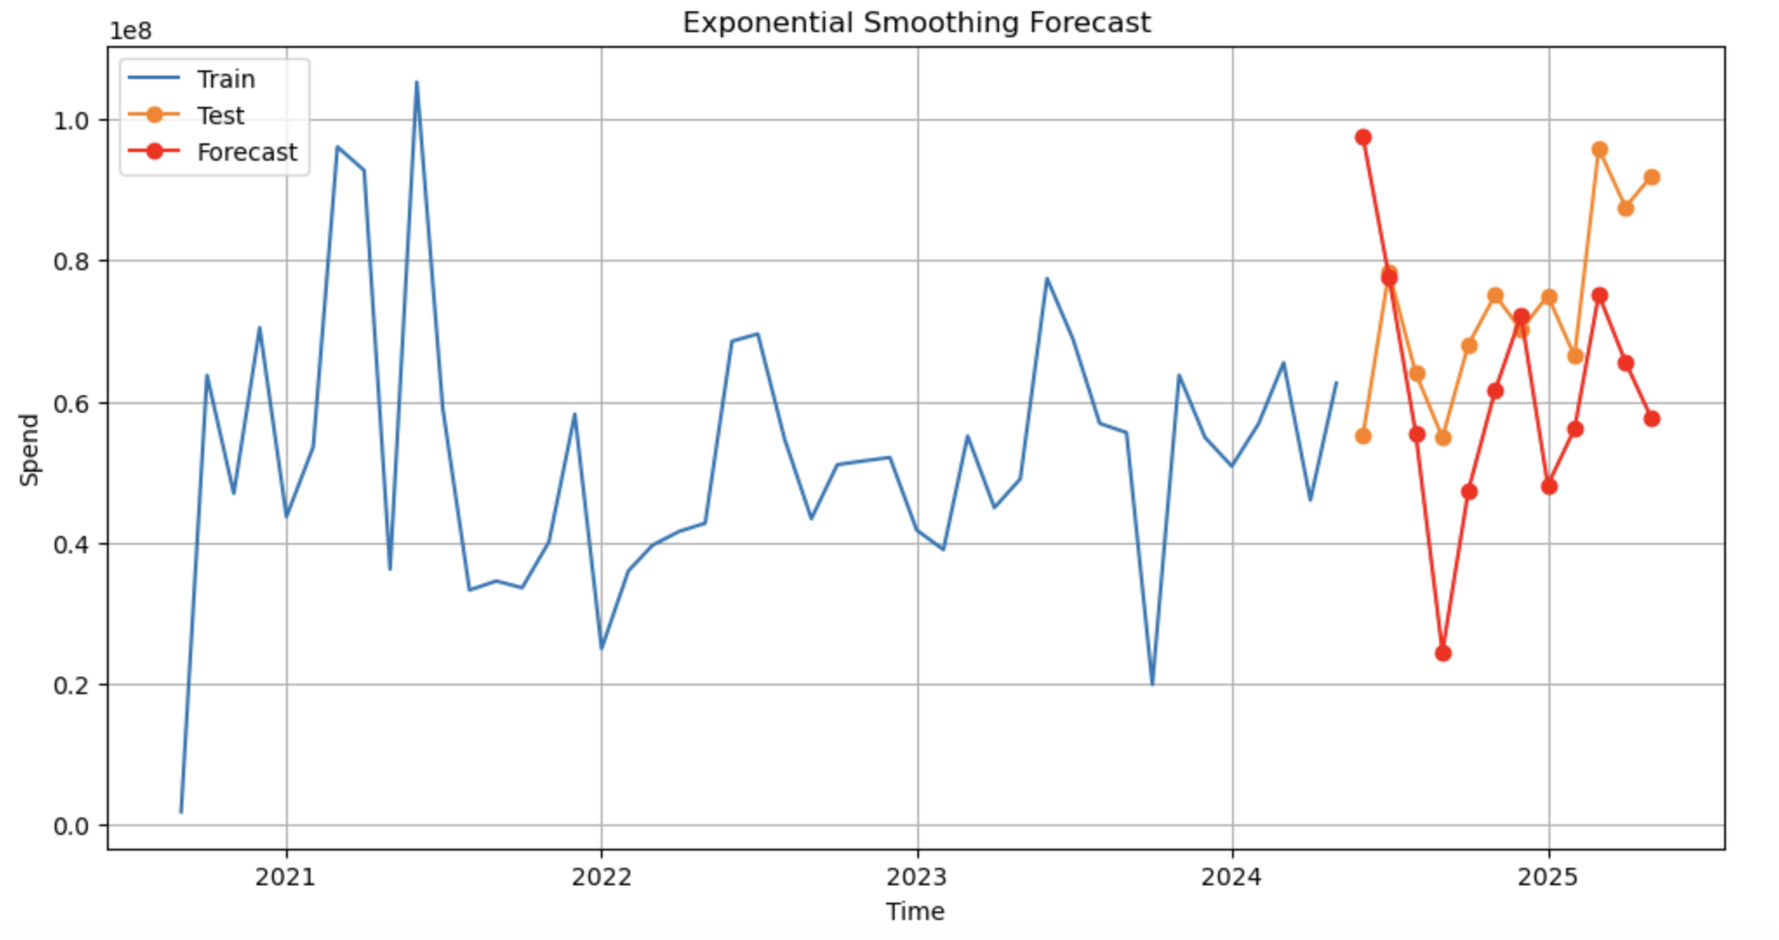
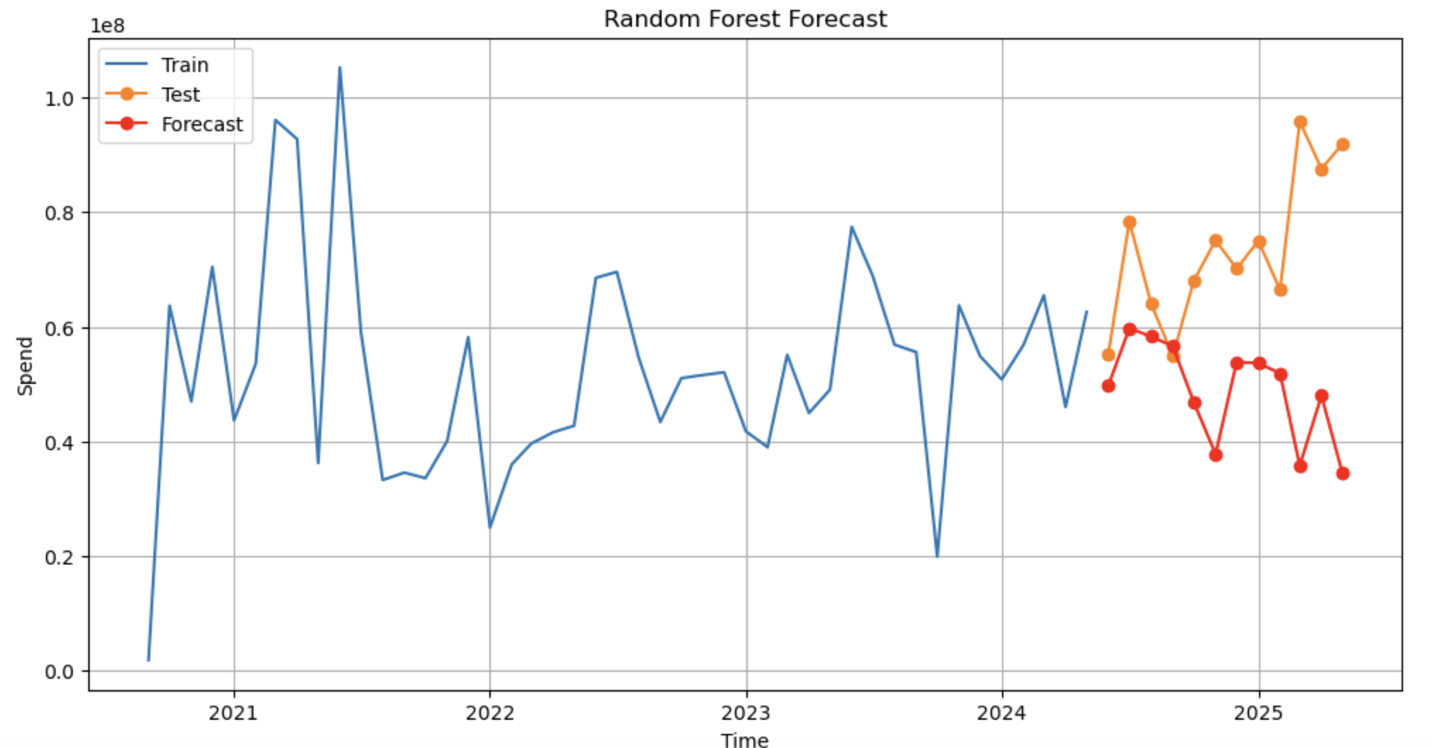
Time Series Forecasting Results
ARIMA
Exponential Smoothing
Random Forest
MAE | $25.4M | $19.4M | $25.0M
RMSE | $28.4M | $22.9M | $31.2M
MAPE | 32.60% | 27.70% | 30.90%
Exponential Smoothing was seen to be the best overall across all accuracy metrics and was further fine tuned to a model with 17.2% MAPE

Slide 9
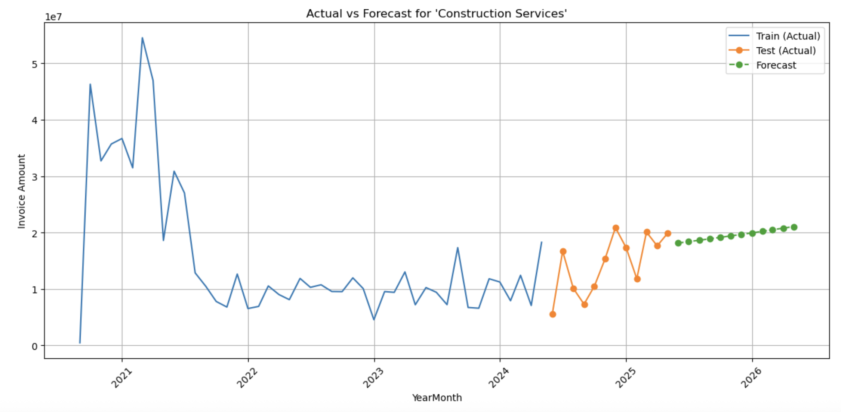
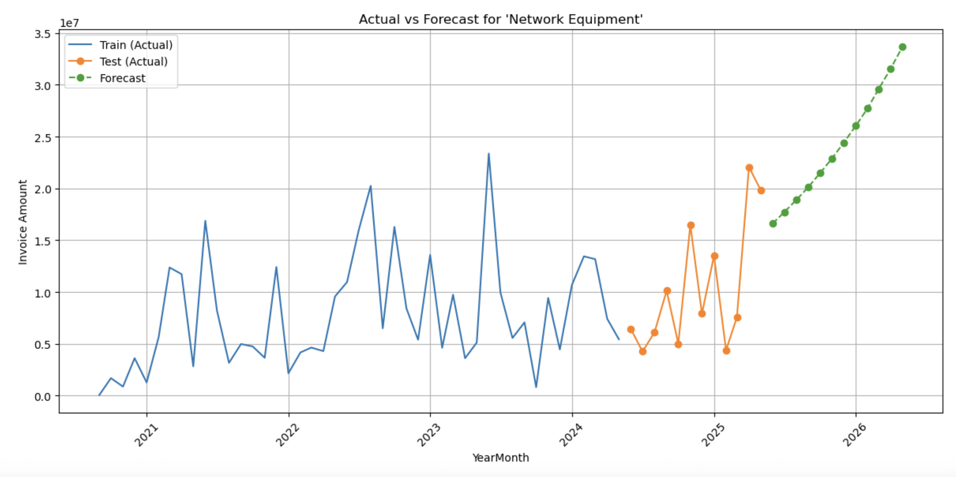
Time Series Forecasting Insights (Top Spend Categories)
All spend categories show an increase spend trend on future forecast - monitor spend and behaviour to ensure business is fully equipped and informed and any potential risks are mitigated
Network Equipment - steep increase in spend
Critical category in the transition to renewable energy in Australia
Critical for spend budgeting and strategic negotiations as this is a key business cost driver
Increase in spend can relate to increase in demand
Focus on Supplier Relationship Management for key equipment suppliers
Early planning is critical to ensure continuity of service
Construction Services
Network Equipment

Slide 10
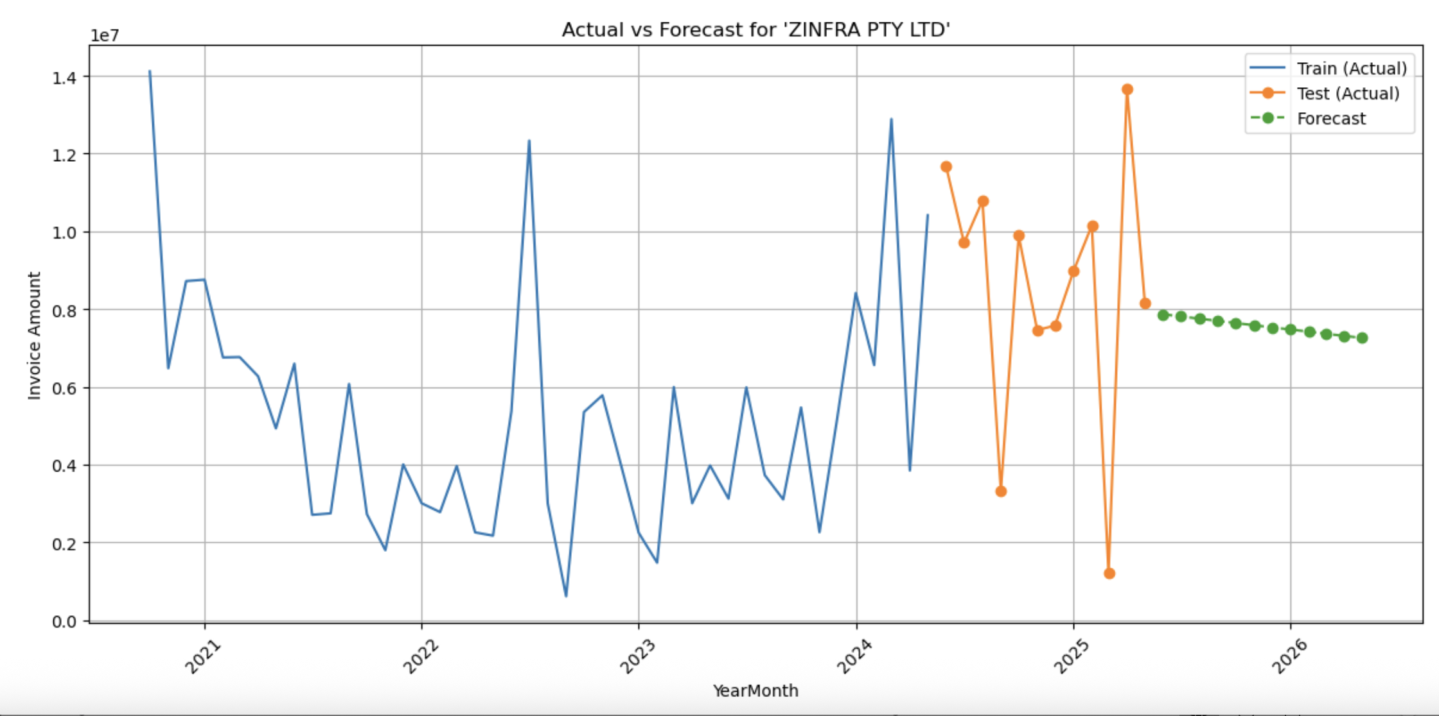
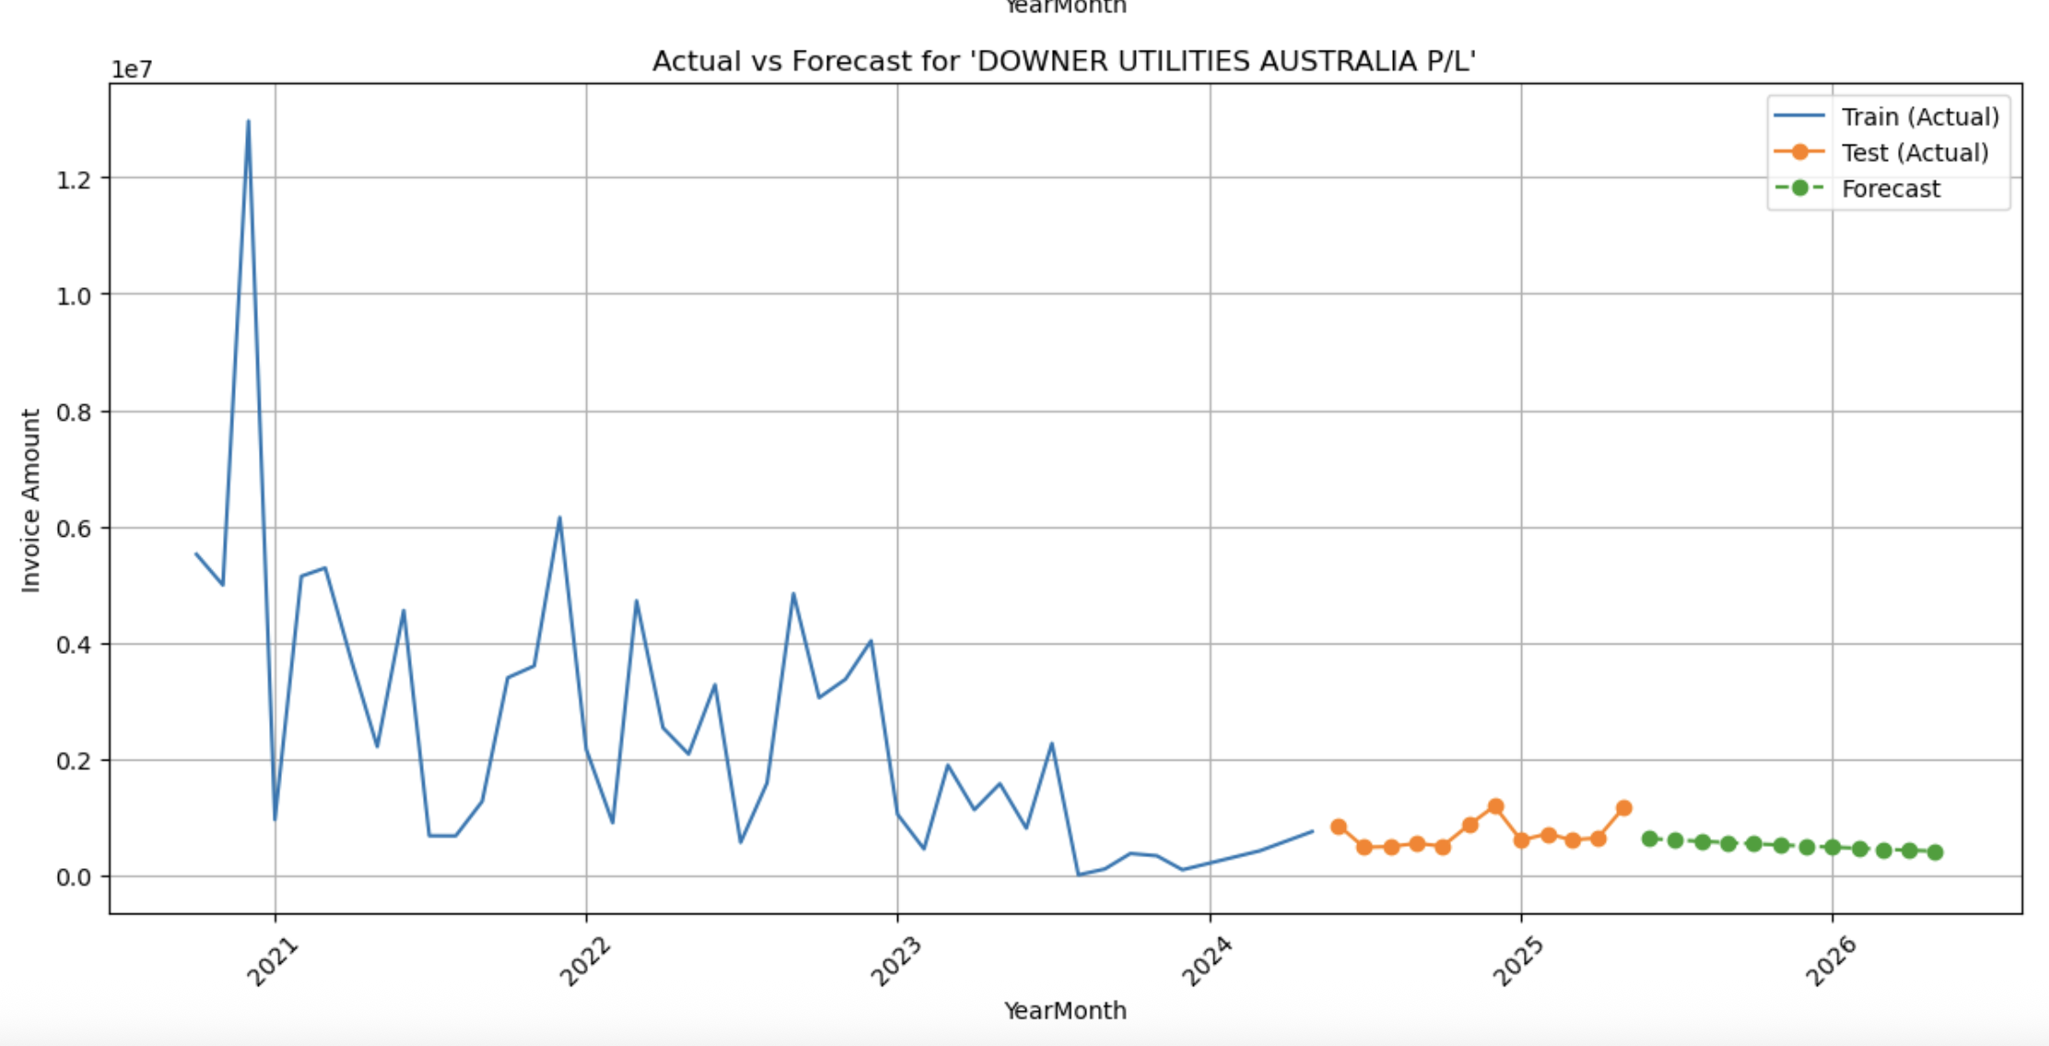
Time Series Forecasting Insights (Top Spend Suppliers)
All top spend suppliers are Construction suppliers
Evident decrease in spend in the last 1 to 2 years for key construction suppliers due to employee contract negotiations which slowed construction activities.
Volatility and potential sudden increase in spend could be expected post contract negotiations
Potentially incorporate seasonality in fine tuning of the model
Importance of continuous supplier relationship management to maintain relationship once construction activities ramp up as construction partners are limited compared to expected demand across Australia
Zinfra
Downer

Slide 11
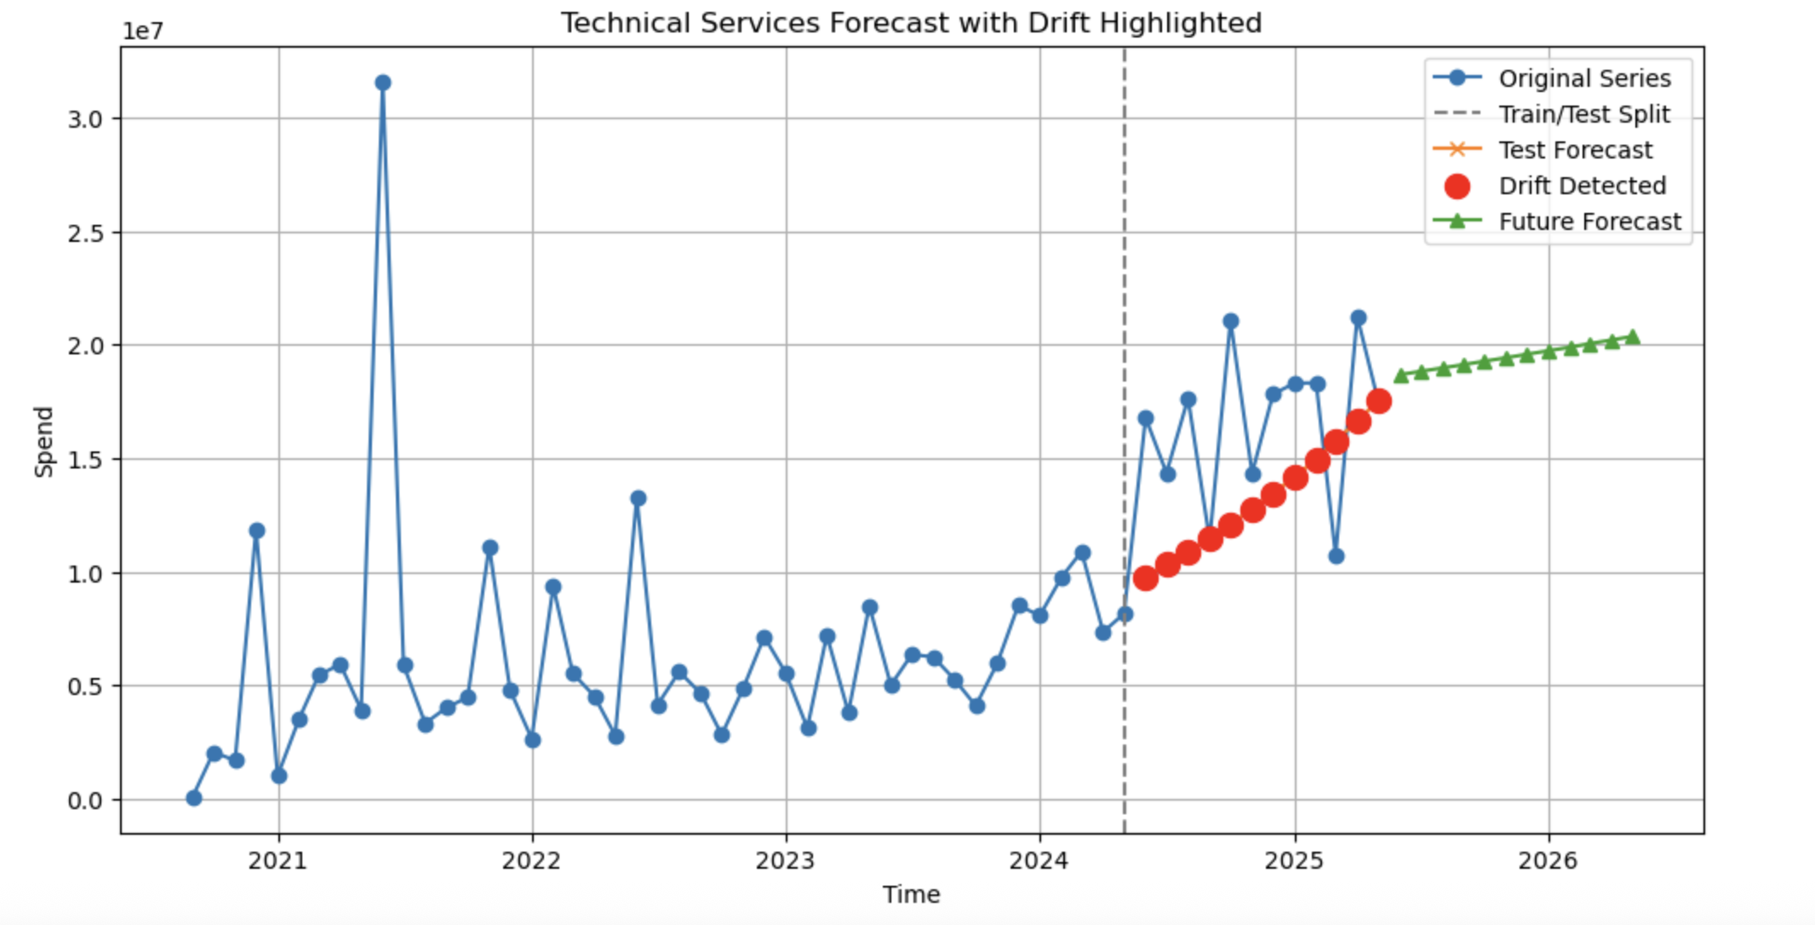
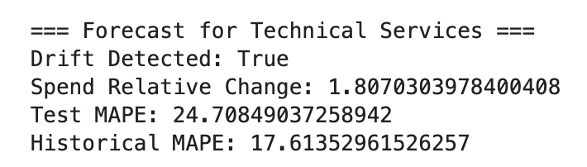
Drift Monitoring
Rule-based drift detection
Time Series Data
Forecasting
Drift Detection
Error Based
Spend Based
MAPE increase (1.5) → concept drift / predictive performance change
Relative spend change (30%) → data distribution drift
Drift Detected

Slide 12







Deployment
1. Run Model in Jupyter Notebook
2. Jupyter Notebook automatically exports CSV Files to one folder with Data Results
3. CSV Files linked to Power BI for Visualisation

Slide 13
Conclusion
Voice of Customer
Stage 1
Invoice Spend Classification
Accurate spend information and guidance
A solution to correctly classify invoices, illustrate and predict spend and category trends through time and deploy for business consumption has been developed.
Great starting point to enable and drive faster, more agile and informed decisions through smarter spend and supplier insights for multiple stakeholders.
Stage 2
Time Series Spend Forecasting
Spend trends and forecast through time by supplier and category
Stage 3
Drift Monitoring
Category and supplier change in behaviour
Stage 4
Deployment
Spend Monitoring and Management
Category Planning and Management

Slide 14
It does not stop there…

Slide 15
Turn Data Solution to Actionable Insights
This is an Ongoing Process of Continuous Improvement, Monitoring, Analysis and Reporting of models and results is key to ensure this benefits the business and its goals
Supplier Relationship Management
Criticality of Planning Ahead – especially for Network Equipment category
Shift to a Less Tactical & More Strategic Procurement
Business Planning (resources etc.) for expected uptake of volume and value of activity
Early Risk Identification and Management

Slide 16
Future Work on Data Solution
Fine-tune Forecasting Pipeline: Continue refining the current forecasting pipeline to improve accuracy and robustness.
Hybrid Forecasting Approaches: Explore hybrid models that combine statistical forecasting methods with machine learning techniques.
Full End-to-End Pipeline: Integrate invoice classification models with the forecasting pipeline to build a comprehensive spend analytics solution.
Granular Forecasting: Extend forecasting to more detailed spend categories and supplier groupings for deeper insights.
Domain Knowledge Integration: Incorporate business and stakeholder input to adjust for known one-off events and seasonalities that may distort forecasts.
Power BI Dashboard Creation and Deployment Options: Evaluate alternative deployment methods (e.g., dashboards, applications) in line with company policies and requirements on data security.

Slide 17
Thank you!

